Slide 1
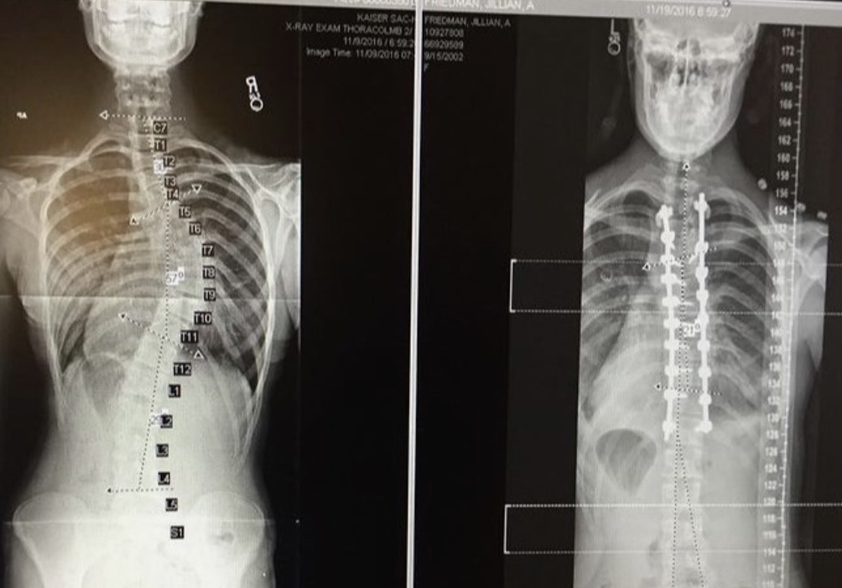
Idiopathic and Neuromuscular Scoliosis in a Female College Basketball Player Requiring Spinal Correction Surgery Magan Kim, ATS University of Nebraska at Omaha, Omaha, NE
Context
Signs and Symptoms
Rehabilitation
Individuals with scoliosis, operative or non-operative, reported to participate in less than 1–3 days/week of physical exercise.¹
Non-contact sports are recommended for patients with scoliosis; prevalence of idiopathic scoliosis is highest in ballet dance.³
Scoliosis patients have a loss of spinal flexibility post-spinal fusion, and athletes produce massive spinal rotations during high-effort running.²
Currently, there is very little existing research following patients that have undergone scoliosis correction surgeries and now participate in athletics.
Sophomore NAIA female basketball player (20 years old, height=1.91 m, mass=86.2 kg).
Participation in sports since she was able to walk (her father was a basketball player, now basketball coach).
Diagnosed with a combination of neuromuscular and idiopathic scoliosis back in 2015, while only in the sixth grade.
Scoliosis is “genetic” on mom’s side of the family and skips a generation (her mom’s dad (grandpa) had it but not her mom).
Wore a back brace for roughly three years while waiting to proceed with spinal correction surgery because surgeons had to wait for her growth plates to fully form.
Pre-spinal fusion, her spinal curvature was a 59% curve in her T2-T8 and a 35% curve in her T8-T12 (see Figure 1A).
Due to the excessive curvature, surgery was required. It was causing stretched ligaments and rotating ribs resulting in organ distress.
Suffered from major back pain and stiffness.
Congenital Scoliosis
Spina Bifida
Syringomyelia
Leg-Length Discrepancy
Cerebral Palsy
Thoracic spinal fusion surgery from T2-T12 using 12 screws and two titanium rods in 2017.
Prescription pain killers made patient ill and nauseous, so ingested 600 mg ibuprofen every six hours and 800mg acetaminophen every eight hours.
Patient was hospitalized for seven days after her surgery; had to be able to pass stool independently and walk five consecutive laps around her hospital floor in order to be released.
Back brace was mandatory and worn 24/7 for three months.
CURRENT TREATMENT:
Instrument-assisted soft tissue mobilization using Graston technique (Fig. 2).
Occasional 800mg ibuprofen for sporadic back pain.
Athlete was not to lift over 10 pounds for two months post-op.
Athlete also could not run for three months post-op.
Walking and going up and down stairs was only form of exercise for first two months post-op.
Began stationary biking two months post-op.
Began swimming/aquatic therapy at three months post-op.
Figure 3.
Yoga ball trunk strengthening exercises (Source: scoliosissosclinic)
Background
PT used a lot of resistance band work and yoga ball work to improve mobility and strength of the abdomen, back and shoulder muscles.
Core stability exercises, SL yoga ball bridge and seated yoga ball balancing to strengthen pertinent abdomen and back muscles (Fig. 3).
Began RTP protocol for sport at seven months post-op.
Back brace had to be worn at all times for several years post-surgery and could only remove it to participate in sport.
Differential Diagnosis
Uniqueness
Not all cases of scoliosis require surgery, but the severeness of this case made surgery urgent.
It is rare to be diagnosed with more than one form of scoliosis and participate in a collegiate contact sport.
Figure 2. Graston for soft tissue mobilization and scar tissue break up (Source: movementstudio. Image by Dr. Graham Rock)
Conclusion
(A)
Treatment
Scoliosis patients, operative or non-operative, should be encouraged to be fit, and live normal, healthy lives.
Clinicians, surgeons, other healthcare providers and patients must stop being so hesitant and afraid of athletic participation in contact sports due to scoliosis; other than cases of extreme curvature, our spines are still very durable and sturdy structures. Even with extreme spine curvature, we now have the technology to perform correction surgeries to give that stability back to the spine.
(B)
References
Kakar RS, Simpson KJ, DAS BM, Brown CN. Review of Physical Activity Benefits and Potential Considerations for Individuals with Surgical Fusion of Spine for Scoliosis. Int J Exerc Sci. 2017 Mar 1;10(2):166-177. PMID: 28344731; PMCID: PMC5360376.Moffet et al.. Early and intensive physiotherapy accelerates recovery postarthroscopic meniscectomy: results of a randomized controlled study. Arch Phys Med Rehabil. (1994);75:415-426.
Kakar, R. S., Li, Y., Brown, C. N., Oswald, T. S., & Simpson, K. J. (2019). Spine and Lower Extremity Kinematics Exhibited During Running by Adolescent Idiopathic Scoliosis Patients With Spinal Fusion. Spine deformity, 7(2), 254–261. https://doi.org/10.1016/j.jspd.2018.08.015
Mousavi L, Seidi F, Minoonejad H, Nikouei F. Prevalence of idiopathic scoliosis in athletes: a systematic review and meta-analysis. BMJ Open Sport Exerc Med. 2022;8(3):e001312. Published 2022 Aug 5. doi:10.1136/bmjsem-2022-001312
Figure 1. X-Ray. (A) posterior view, pre-surgical spine with extreme curvature
(B) posterior view, post-surgical spine with two titanium rods.

