Slide 1
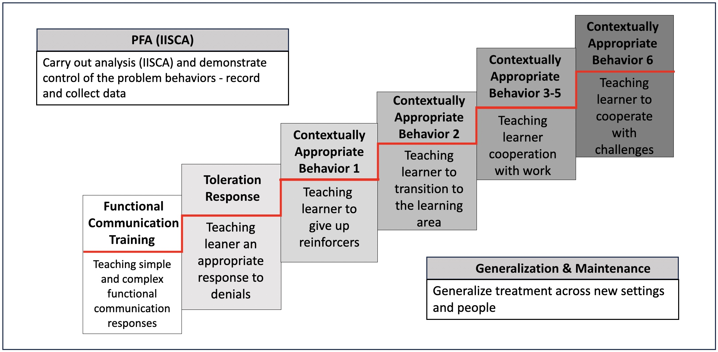
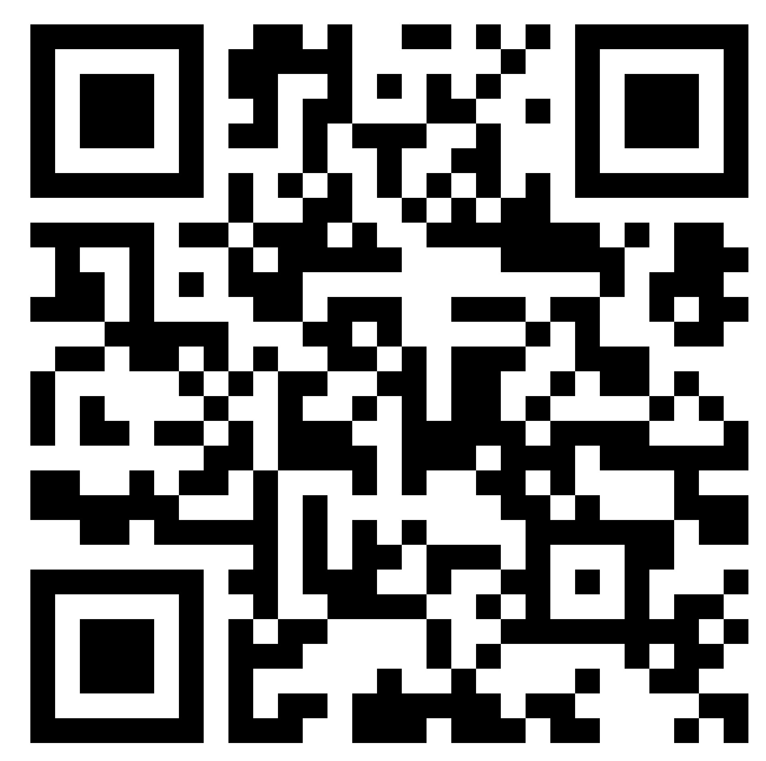
University of Nebraska at Omaha
How to Successfully Implement Practical Functional Assessment in School Settings
Christina C. Arispe MS, Alexis M. Westercamp, Sara Kupzyk PhD, LP, BCBA, & Adam D. Weaver PhD, BCBA
University of Nebraska at Omaha
Abstract
BIP and SBT
The Practical Functional Assessment (PFA) and Skill-Based Treatment (SBT) process is a comprehensive system that may benefit students who engage in high levels of challenging behavior by assessing the function of behavior while considering the student’s safety, dignity, and autonomy (Hanley, 2012).
The PFA-SBT process is designed to advance through several cumulative phases to teach the necessary skills that promote student success in multiple contexts within the school or home (Hanley et al., 2014). While not explicitly designed for school settings, the PFA-SBT process is versatile and feasible enough to be implemented by school personnel. This poster will describe the PFA-SBT process, present tips for successful implementation, and discuss social validity.
The SBT portion should be incorporated into the student's BIP.
Data from the SBT Planning Workbook can be used as a guide for skill progression in a BIP (Egan, 2023).
Identifying intervention strategies to be used to alter antecedent events and to prevent the occurrence of the behavior occurs throughout all stages of SBT.
Teaching the student alternative strategies and adaptive behaviors is implemented through functional communication, delay/denial, and toleration (Slaton et al., 2017).
SBT assists in identifying appropriate responses to challenging and alternative behaviors.
Student progression of BIP goals can be accomplished through the graphing tool and the PFA-SBT workbook.
The PFA-SBT Process
Interview-Informed Synthesized Contingency Analysis (IISCA) is used to gather information about the student's history, preferences, and behaviors.
Data are used to determine the environmental conditions tested in a PFA which can be combined conditions based on data (Slaton et al., 2017).
SBT sessions aim to progressively implement a situation in which challenging behavior is more likely to occur while teaching adaptive behavior in several phases.
Begin the SBT process (see figure) with the overall goal of providing intermittent and unpredictable reinforcement to teach students life skills through functional communication, delay/denial tolerance, and compliance.
School staff, such as teachers, school psychologists, and paras, can be qualified to implement PFA-SBT under supervision through self-paced training (e.g., FTF Behavioral Consulting on demand course).
Implementors complete the student's PFA-SBT workbook as they move through the process.
Data collection and progress monitoring occur through the PFA Data App, providing detailed graphs for progress monitoring.
SBT should be conducted by a trained implementor at least four hours per week during scheduled times.
Social Validity
Slaton et al. (2018) demonstrated that treatments informed by the PFA eliminated challenging behavior and resulted in acquisition of a functional communicative response in 100% of cases across multiple contexts.
Teachers reported high satisfaction with the functional communication, tolerance, and compliance skills that were achieved in a school setting (Santiago et al., 2015).
Students with emotional and behavioral disorders receiving SBT with an enhanced choice model in their classrooms reduced severe challenging behavior while increasing alternate communicative responses (Staubitz et al., 2022).
FBA, IISCA, and PFA
A Functional Behavior Assessment (FBA) is required by IDEA in certain situations. The FBA is then used to develop a Behavior Intervention Plan (BIP).
The IISCA and PFA can be incorporated into the FBA process to determine maintaining contingencies (i.e., the function of challenging behavior) and to inform behavioral interventions.
The IISCA may be more feasible and efficient in school settings than a traditional functional analysis in the FBA (Hanley, 2014).
The open-ended interview in the IISCA can be used as part of an indirect assessment in an FBA (Hanley, 2014).
The open-ended interview assists in identifying the challenging behaviors to target in the PFA process which acknowledges defining the behavior within the FBA (Egan, 2023).
The antecedents, reinforcing consequences, and alternative skills to be taught sections in an FBA can be completed according to the PFA results (Egan, 2023).
References
Egan, C. (2023). Aligning PFA with IEP assessment requirements. [PowerPoint Slides]. FTF Behavioral Consulting. https://ftfbc.com/wp-content/uploads/2023/07/IEP-Course-Handouts.pdf
FTF Behavioral Consulting. (2021, December 18). Practical Functional Assessment and Skill-Based Treatment - FTF Behavioral Consulting. FTF Behavioral Consulting -. https://ftfbc.com/pfa-sbt/
Hanley, G. P., Jin, C. S., Vanselow, N. R., & Hanratty, L. A. (2014). Producing meaningful improvements in problem behavior of children with autism via synthesized assessments and treatments. Journal of Applied Behavior Analysis, 47(1), 16-36. https://doi.org/10.1002
Santiago, J.L., Hanley, G.P., Moore, K. et al. The Generality of Interview-Informed Functional Analyses: Systematic Replications in School and Home. J Autism Dev Disord 46, 797–811 (2016). https://doi.org/10.1007/s10803-015-2617-0
Slaton, J.D. and Hanley, G.P. (2018) ‘Nature and scope of synthesis in functional analysis and treatment of problem behavior’, Journal of Applied Behavior Analysis, 51(4), pp. 943–973. doi:10.1002/jaba.498.
Slaton, J. D., Hanley, G. P., & Raftery, K. J. (2017). Interview-informed functional assessments: A comparison of synthesized and isolated components. Journal of applied behavior assessment, 50(2), 252–277. https://doi.org/10.1002/jaba.384/jaba.106
Staubitz, J.L. et al. (2022) ‘Effects of an enhanced choice model of skill‐based treatment for students with emotional/behavioral disorders’, Journal of Applied Behavior Analysis, 55(4), pp. 1306–1341. doi:10.1002/jaba.952.
For a Frequently Asked Questions document on the PFA-SBT process for caregivers and implementors, use your smartphone to scan this QR code.

